Slide 1
Natural Language Processing With Deep Learning
Lecture 1: Introduction, Logistics, and Words
Instructor: Stefan Lee (he/him/his)

Slide 2
Be able to answer:
What is Natural Language Processing (NLP)?
What are some applications?
Why is it challenging?
What is Deep Learning?
How is this course structured and graded?
What is a word?
What is a word sense?
How might we represent words for ML?

Slide 3



CS539 – Natural Language Processing with Deep Learning Overview
Zoom Policy:
Do I have to have my video on?
No, but please do if it doesn’t bother your learning experience. It might help make the class less boring (at minimum for me).
How do I ask a question?
Most effective – just unmute and interrupt me if its time sensitive.
Second best – ask in chat. I’ll try to see these in a timely manner.
Conduct
No side conversations in chat. Private messages are disabled.
Zero tolerance for abusive language or inappropriate video content. Violators will be removed from lecture and reported.

Slide 4


Natural Language Processing
Natural Language Processing (NLP)
vocab
Broadly defined as the area of study concerned with the interactions between computers and human language
WORDS
WORDS
Meaning

Slide 5
Intellectual Heritage of NLP
Computer Science
(Computational) Linguistics
Machine Learning
Natural Language Processing (NLP)

Slide 6




NLP Applications In Your Daily Life

Slide 7

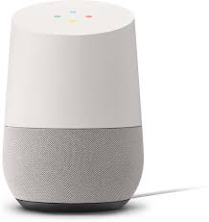

NLP Applications In Your Daily Life
Speech Recognition
Play songs by The Mountain Goats

Slide 8



NLP Applications In Your Daily Life
Semantic Parsing
Play songs by The Mountain Goats
play( playlist_by_artist(“The Mountain Goats”))

Slide 9
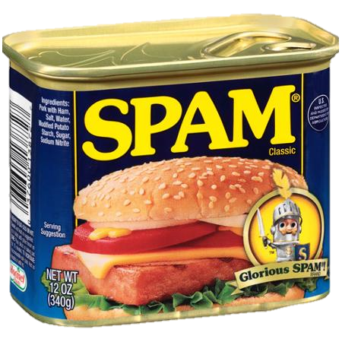



NLP Applications In Your Daily Life

Slide 10
NLP Applications In Your Daily Life
Spam Detection

Slide 11
NLP Applications In Your Daily Life
Predictive Text
Hello Prof. Stefan,
I was in your NLP+DL course and am now working on machine translation. Would you be willing to write me a letter of recommendation?
Best,
Mae Dupp ---- 学而不思则罔，思而不学则殆 - 孔夫子
Absolutely.
No. You missed every lecture.
Sounds good.
Note: This email is fictional as are the predicted responses.

Slide 12
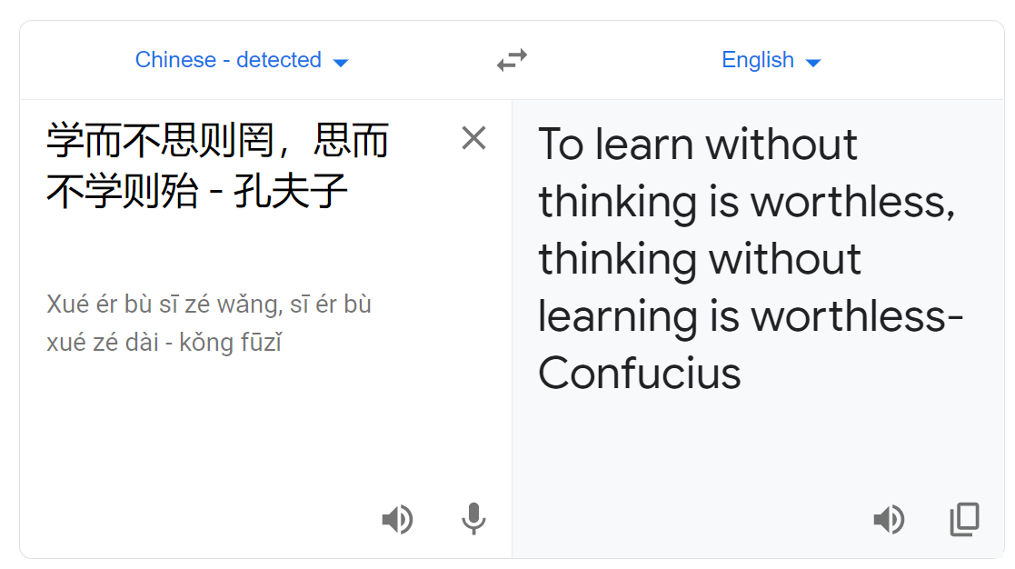
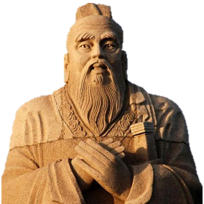
NLP Applications In Your Daily Life
Machine Translation

Slide 13
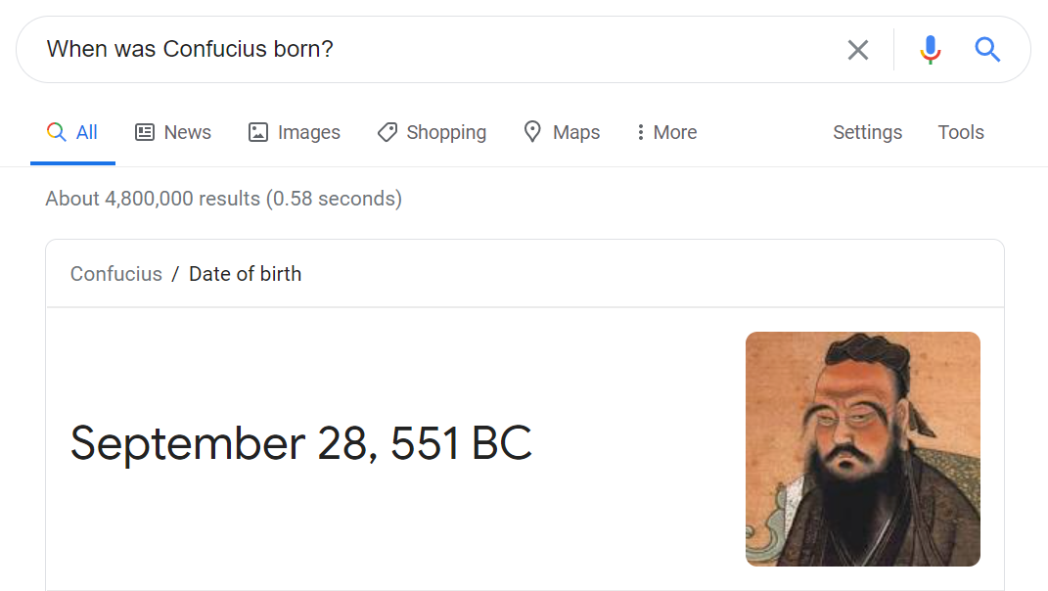
NLP Applications In Your Daily Life
Question Answering

Slide 14


NLP Applications In Your Daily Life
Grammar / Spell Check
Dear hiring committee,
Mae Dupp’s positive affect on my coarse cannot be undrstated. She consistently …
effect
course
understated

Slide 15


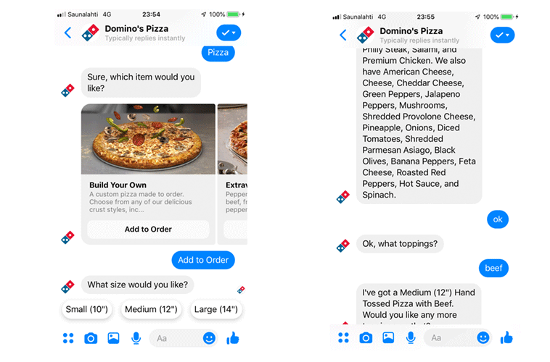

NLP Applications In Your Daily Life
Hate Speech Detection
Chat Bots
Sentiment Analysis
Document Summarization
reddit.com/r/autotldr

Slide 16
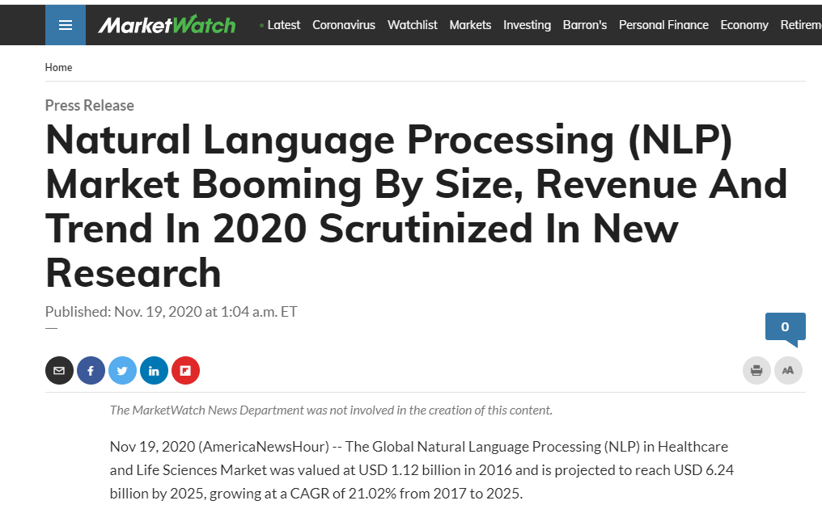
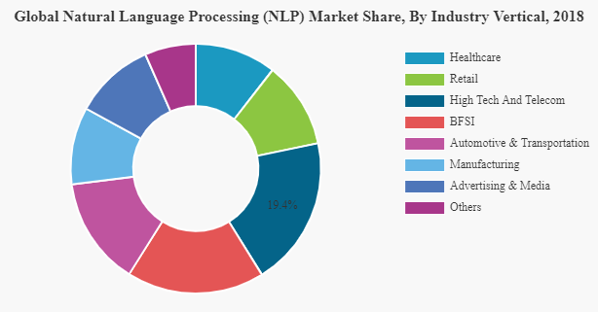
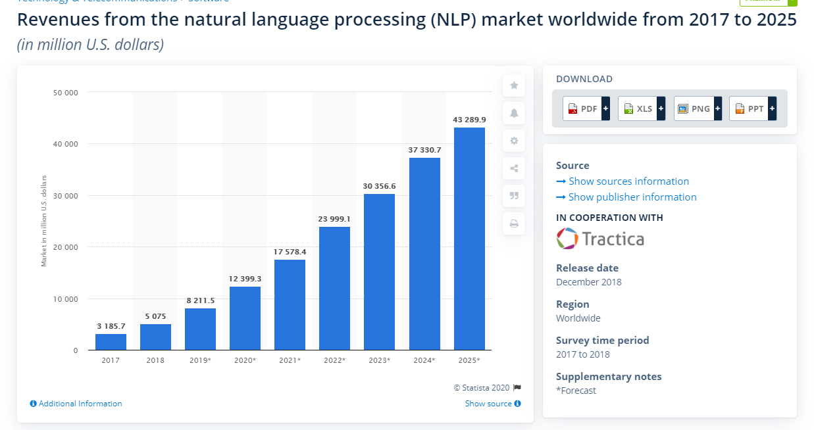
Still not convinced? Do you like $$?

Slide 17
Why is Natural Language Processing difficult?
WORDS
WORDS
Ambiguity
Ambiguity
Meaning
Ambiguity
Also, a huge search space, non-stationary distribution, and a long-tail of Infrequent words --- But that makes for a big stamp

Slide 18



Examples of Ambiguity in English
Lexical ambiguity:
How do you make a turtle fast?
Take away their food.
-- moving or capable of moving at high speed
-- abstaining from eating
Polysemy A word or phrase having multiple meanings.

Slide 19




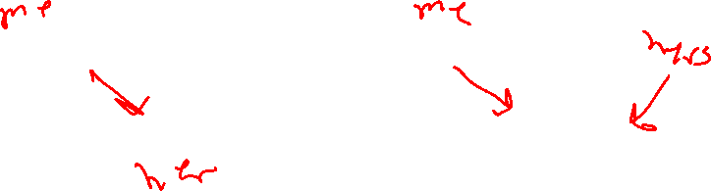
Examples of Ambiguity in English
Lexical ambiguity:
I saw her duck.
Example Credit: Aravind Joshi

Slide 20




Examples of Ambiguity in English
Syntactic ambiguity: Attachment
We eat sushi with chopsticks
I shot an elephant in my pajamas
We eat sushi with soy sauce
or
or

Slide 21


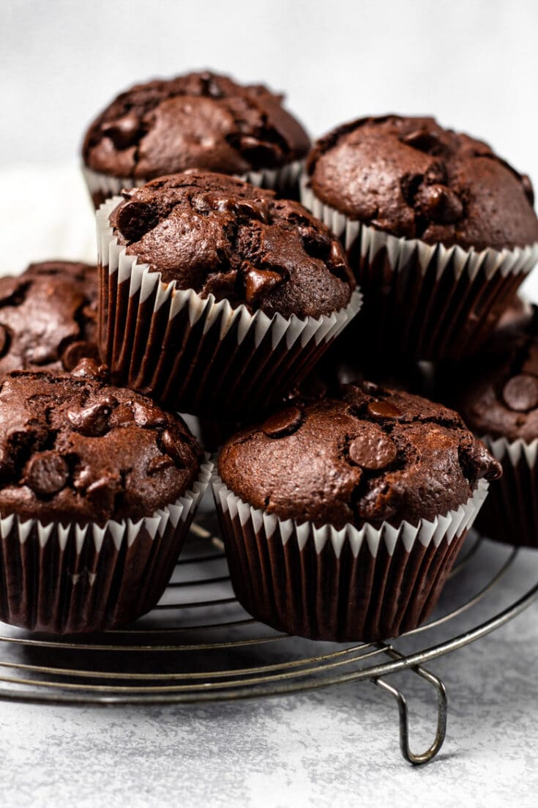
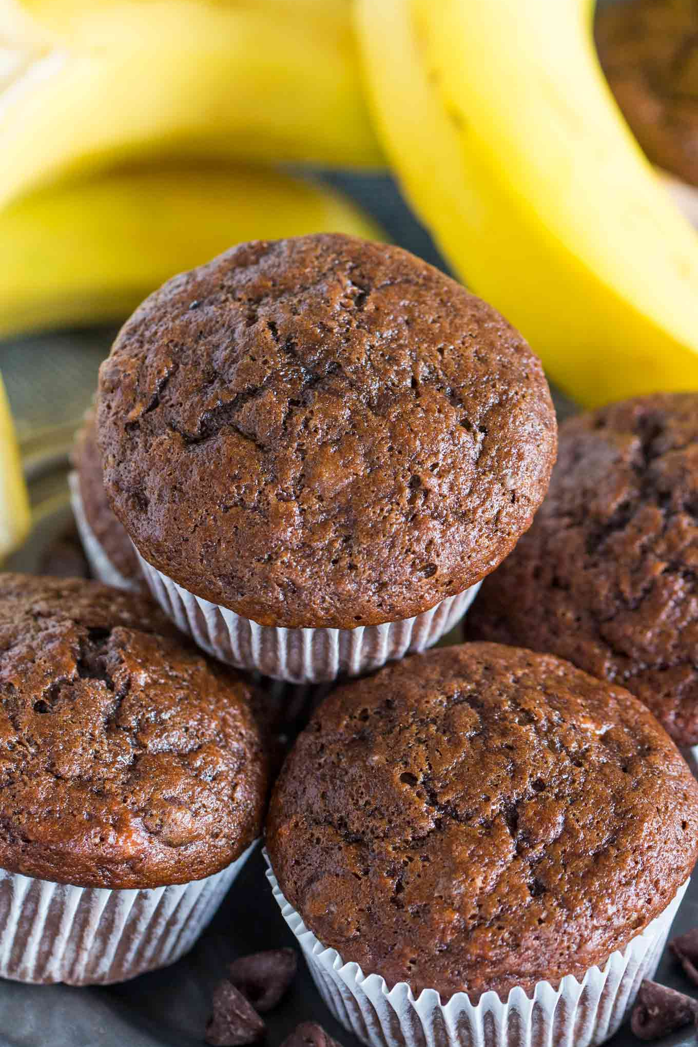
Examples of Ambiguity in English
Syntactic ambiguity: Conjunctive
I like chocolate and banana muffins.
[chocolate] and [banana muffins]
[chocolate muffins] and [banana muffins]
[chocolate and banana] muffins

Slide 22



Examples of Ambiguity in English
Syntactic ambiguity: Coreference
Victoria Chen, CFO of Megabucks Banking, saw her pay jump to $2.3 million

Slide 23
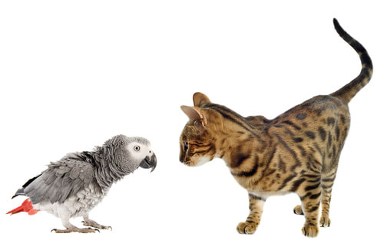
Examples of Ambiguity in English
Semantic ambiguity: Scope
Lucy owns a parrot that is larger than a cat
… larger than a specific cat?
… larger than a typical cat?
… larger than all cats?
Someone causes a fatal car accident every 5 minutes.

Slide 24


Examples of Ambiguity in English
Semantic ambiguity: Underspecification
John kissed his wife, and so did Sam
or
John
Sam
John
Sam
John and Mary are married.
or
Mary
John
Mary
John

Slide 25
Examples of Ambiguity in English
Non-literal speech:
The White House announced today that ….
The cost of a good webcam has gone through the roof.
Do you know what time it is?

Slide 26

Consider the following ambiguous statements. For each, identify the type of ambiguity, how you would interpret it, and what information you used to reach that conclusion.
1) “I dropped the hammer on the table. It shattered.”
2) “The dog’s pen was full of blue ink.”
3) “If three of my relatives die, I will inherit a house.”

Slide 27
How do humans deal with this ambiguity?
WORDS
WORDS
Learn from experience and context what interpretations are likely to be correct.
Machine Learning time

Slide 28
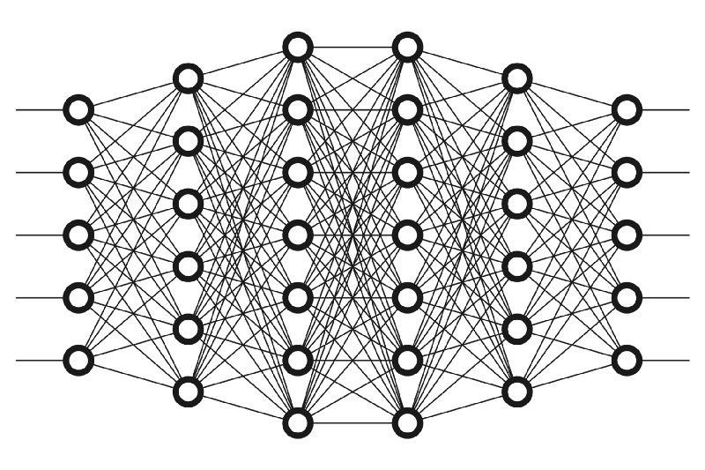
Deep Learning
Deep Learning (DL)
vocab
Machine learning algorithms based on multi-layer neural networks that learn to perform tasks from input, directly learning feature representations
Spam / Not Spam

Slide 29
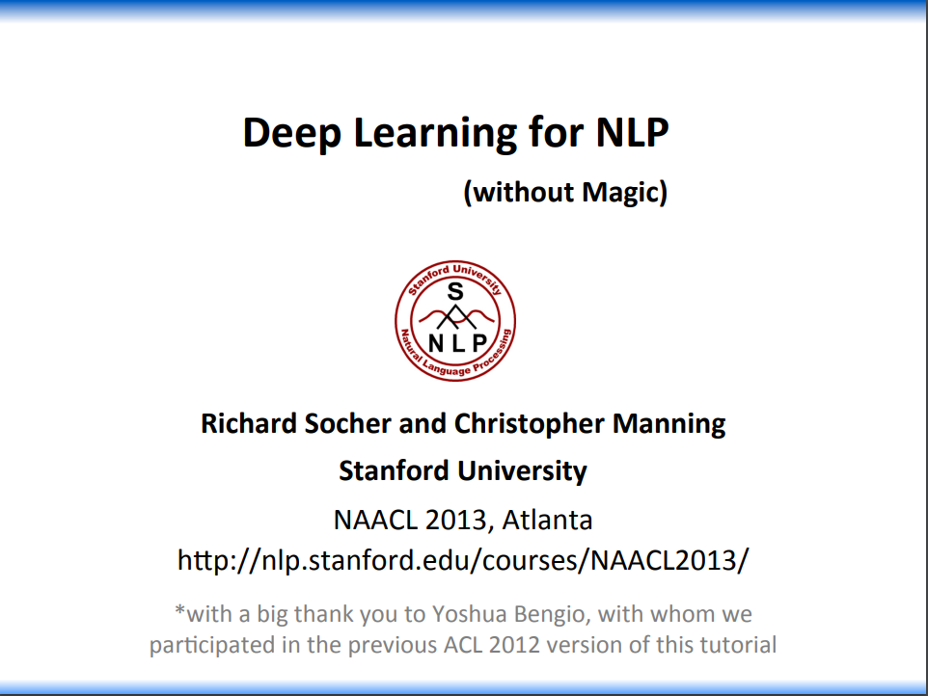
Deep Learning’s Impact on NLP
word2vec

Slide 30
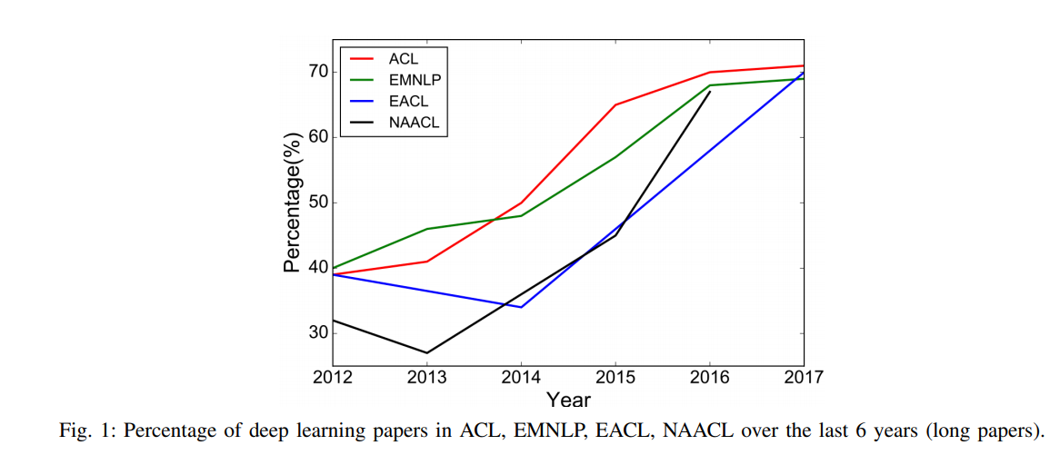
Deep Learning’s Impact on NLP

Slide 31
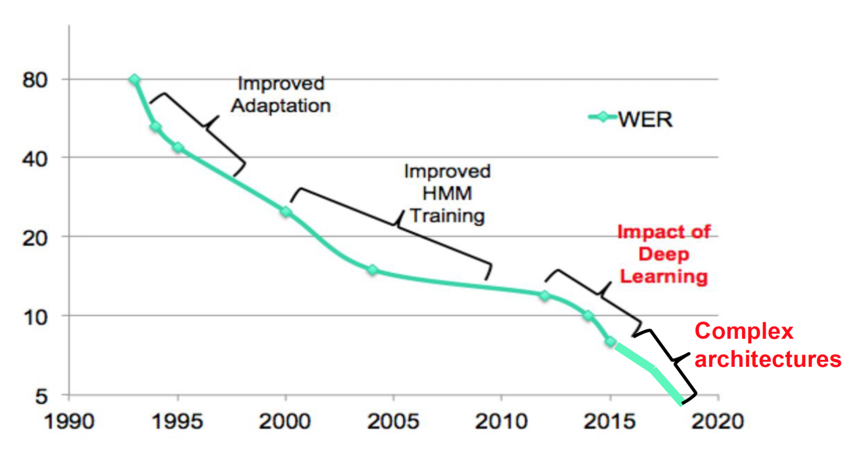
Deep Learning’s Impact on NLP
ASR Performance on English Conversational Telephony (Switchboard)
Taken from Bhuvana Ramabhadran’s presentation at Interspeech 2018

Slide 32
Be able to answer:
What is Natural Language Processing (NLP)?
What are some applications?
Why is it challenging?
What is Deep Learning?
How is this course structured and graded?
What are the expectations for Zoom?
What is a word?
What is a word sense?
How might we represent words for ML?

Slide 33

CS539 – Natural Language Processing with Deep Learning Overview
Instructor: Stefan Lee
Class Period: MWF 4-4:50pm on Zoom (You’re here. Well done)
Office Hours: T 10-11:30am on Zoom
The course covers:
⚒ deep learning techniques for Natural Language Processing,
⚑ how they are applied to common applications, and
⚖ ethical considerations of their use.

Slide 34
CS539 – Natural Language Processing with Deep Learning Overview
Grading / Assessment:
Attendance (5%) – Taking remote classes seriously during a pandemic is difficult. Showing up to lecture is a great first step.
Quizzes (10%) – Quizzes and surveys will be given out periodically on Canvas to track engagement and comprehension of the material. Surveys will be graded on participation. Always due on Fridays. First one out today.
Assignments (55%) – Four assignments over the term each due on Canvas after two weeks. First one out Wednesday.
Final Project (30%) – Group project of ~3-4 people per group.

Slide 35
CS539 – Natural Language Processing with Deep Learning Overview
Assignments: (55% of final grade)
Four assignments scheduled for the term focusing on:
[HW1] Word Vectors and Distributed Representations (Python)
[HW2] RNNs, Memory, and Language Representation (PyTorch)
[HW3] Generative Language Models and Beam Search (PyTorch)
[HW4] Attention in Sequence-to-Sequence Models (PyTorch)
Released on Wednesdays and due 2 weeks later by midnight on Canvas.

Slide 36
CS539 – Natural Language Processing with Deep Learning Overview
Late Work Policy:
Every student will be allotted 7 “late days” for the term that can be used at will.
Extend an assignment deadline by 24 hours. (Not quizzes or projects)
To use late days, include “I am using X late days for this assignment.” in your assignment submission comment on Canvas.
Otherwise, late work loses 15% credit per day.
Collaboration Policy:
Aside from the final project, students are expected to work independently. High-level discussion of topics is allowed, but any low-level details, sharing of code, or collaborative programming are prohibited. Likewise, the use of code from unauthorized online resources is prohibited.

Slide 37
CS539 – Natural Language Processing with Deep Learning Overview
Final Project: (30% of final grade)
NLP-focused project with groups of 3-4 students to be done during the second half of the term. The project can either be self-defined or follow a “default” project path of reproducing a recent paper. Either way, project must be approved before the proposal presentation.
Key Dates:
Project Idea Submission / Review (5%): By 2/3 at the latest via Canvas
Project Proposal Presentation (10%): 2/10 or 2/12 in class
Final Project Presentation (15%): 3/10 or 3/12 in class

Slide 38
CS539 – Natural Language Processing with Deep Learning Overview
Week 1 | Introduction and Word Representations
Week 2 | Basics of Deep Learning from NLP Perspective
Week 3 | Representing Language
Week 4 | Generating Language
Week 5 | Generating Language (cont.) Attention Mechanisms
Week 6 | Attention in Language Models Project Proposals
Week 7 | Self-Supervised Representations
Week 8 | Applications and Recent Developments
Week 9 | Applications and Recent Developments (cont) Grounded Language
Week 10 | Grounded Language (cont.) Final Project Presentations
Schedule subject to change

Slide 39
CS539 – Natural Language Processing with Deep Learning Overview
Am I prepared to succeed in this course?
Maybe? Are you comfortable with …
Manipulating probabilities and distributions [Probability]
Taking derivatives / gradients [Calculus]
Performing common matrix operations [Linear Algebra]
Standard machine learning concepts like… [Machine Learning]
Classification and regression
Loss functions and regularization
Overfitting / Underfitting
Standard computer science concepts like… [Computer Science]
Programming within libraries (skeleton code will be in PyTorch)
Computational complexity (big O notation)

Slide 40
Be able to answer:
What is Natural Language Processing (NLP)?
What are some applications?
Why is it challenging?
What is Deep Learning?
How is this course structured and graded?
What are the expectations for Zoom?
What is a word?
What is a word sense?
How might we represent words for ML?

Slide 41
Natural Language Processing
WORDS
Meaning

Slide 42

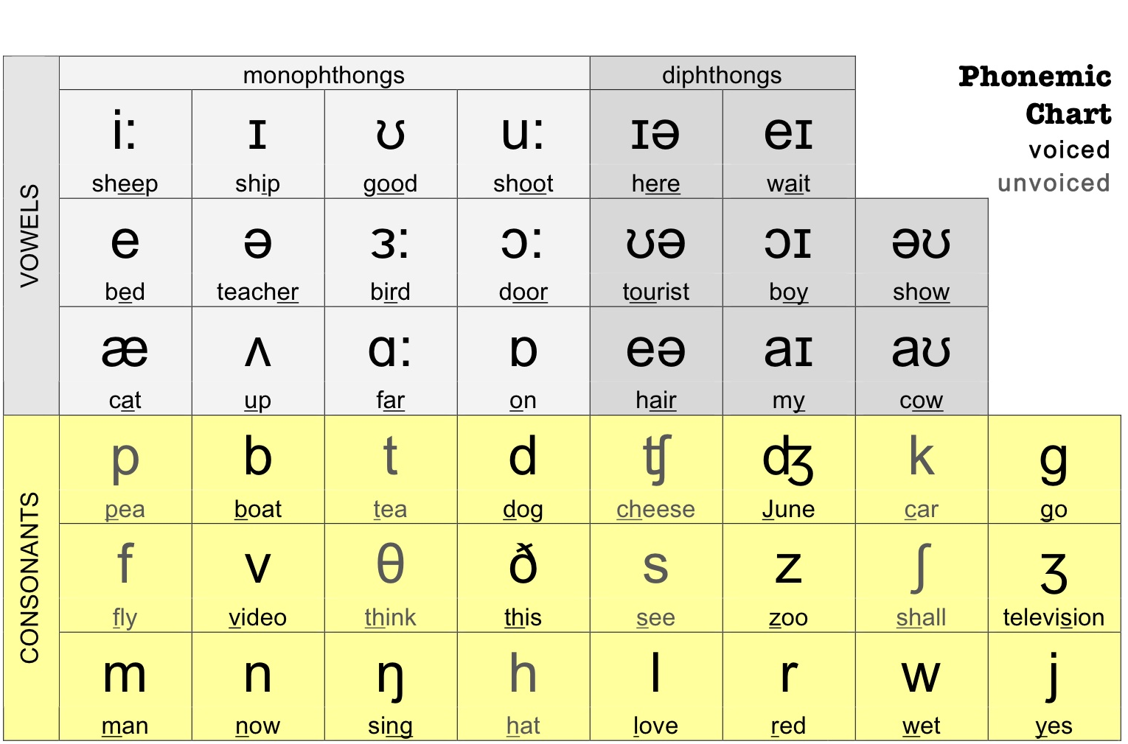
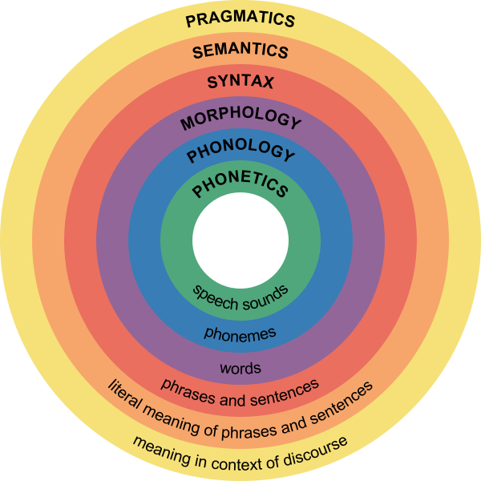
A Brief Tour of Linguistic Structure
English ~ 44 Hindi ~ 48 Mandarin ~ 67
WORDS
WORDS
Phonetics
Study of the sounds humans can make
Graphic Credit: https://commons.wikimedia.org/wiki/File:Major_levels_of_linguistic_structure.svg

Slide 43
A Brief Tour of Linguistic Structure
WORDS
WORDS
/wərds/
Phonology
Study of the patterns of these sounds used in human language
Graphic Credit: https://commons.wikimedia.org/wiki/File:Major_levels_of_linguistic_structure.svg

Slide 44
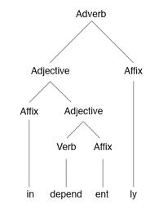
A Brief Tour of Linguistic Structure
Independently
Morphology
Study of the form of words
Graphic Credit: https://commons.wikimedia.org/wiki/File:Major_levels_of_linguistic_structure.svg

Slide 45
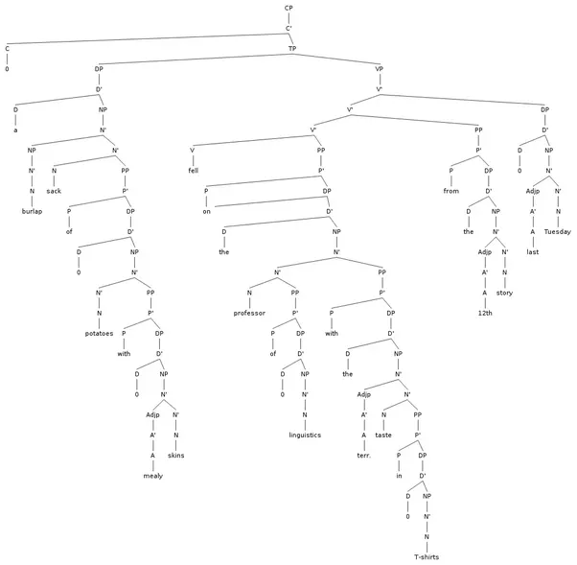
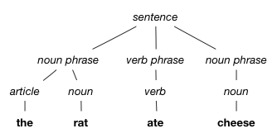
A Brief Tour of Linguistic Structure
The rat ate cheese
⚑ Syntactic Parsing
Syntax
Study of the structure of sentences
Graphic Credit: https://commons.wikimedia.org/wiki/File:Major_levels_of_linguistic_structure.svg

Slide 46

A Brief Tour of Linguistic Structure
The rat ate cheese
Semantics
Study of meaning in language
Graphic Credit: https://commons.wikimedia.org/wiki/File:Major_levels_of_linguistic_structure.svg

Slide 47

A Brief Tour of Linguistic Structure
From a friend during lunch?
Do you know what time it is?
From your mother when you get home at 3am?
From a DJ at a night club?
Pragmatics
Study of meaning in language in context of discourse / dialog / situation
Graphic Credit: https://commons.wikimedia.org/wiki/File:Major_levels_of_linguistic_structure.svg

Slide 48
This seems like a lot.
Let’s start small. What is a word?

Slide 49

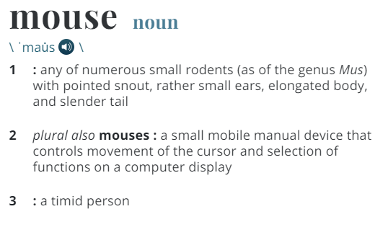
Words, Word-senses, and their Relations

Slide 50
Words, Word-senses, and their Relations
lemma
vocab
Dictionary form of a word
e.g. runs, running, ran → run
word sense
vocab
A meaning of a word
⚑ Word Sense Disambiguation

Slide 51
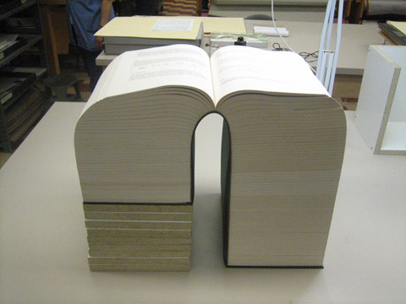
Words, Word-senses, and their Relations

Slide 52

Words, Word-senses, and their Relations

Slide 53
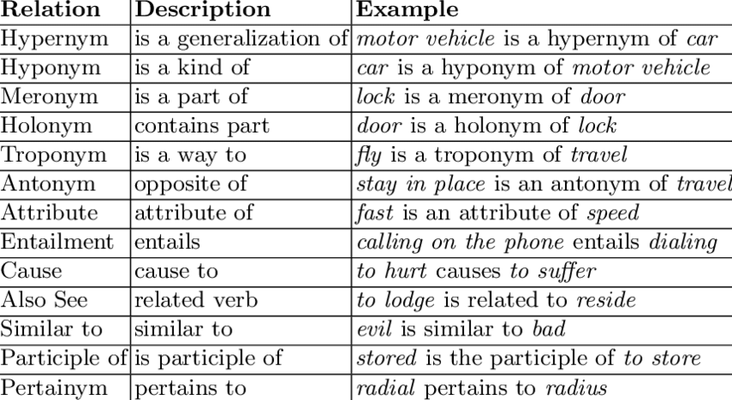
Words, Word-senses, and their Relations
Idea: Define a set of relationships between words and put them all together in a huge graph to represent their meaning.

Slide 54
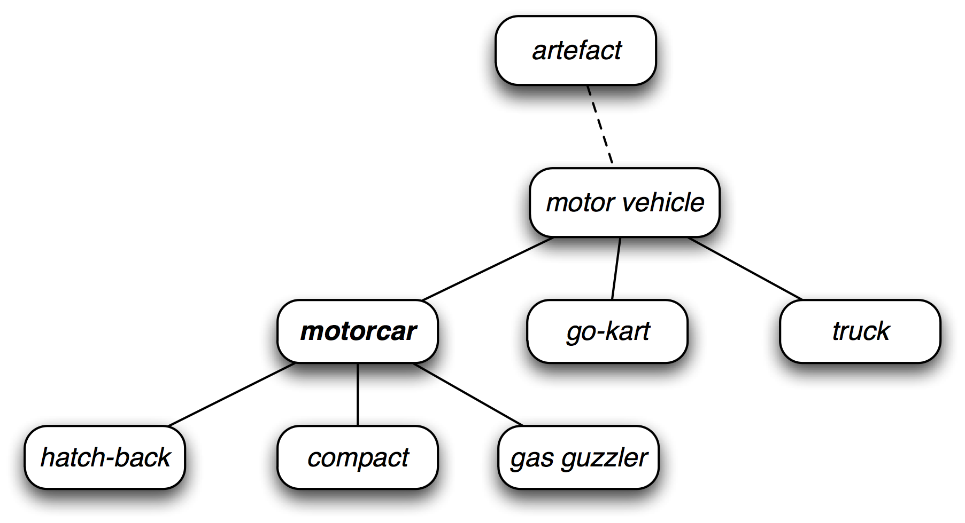

WordNet
Idea: Define a set of relationships between words and put them all together in a huge graph to represent their meaning.
wordnet.princeton.edu
Graphic Credit: Alina Ene and Kevin Wayne

Slide 55
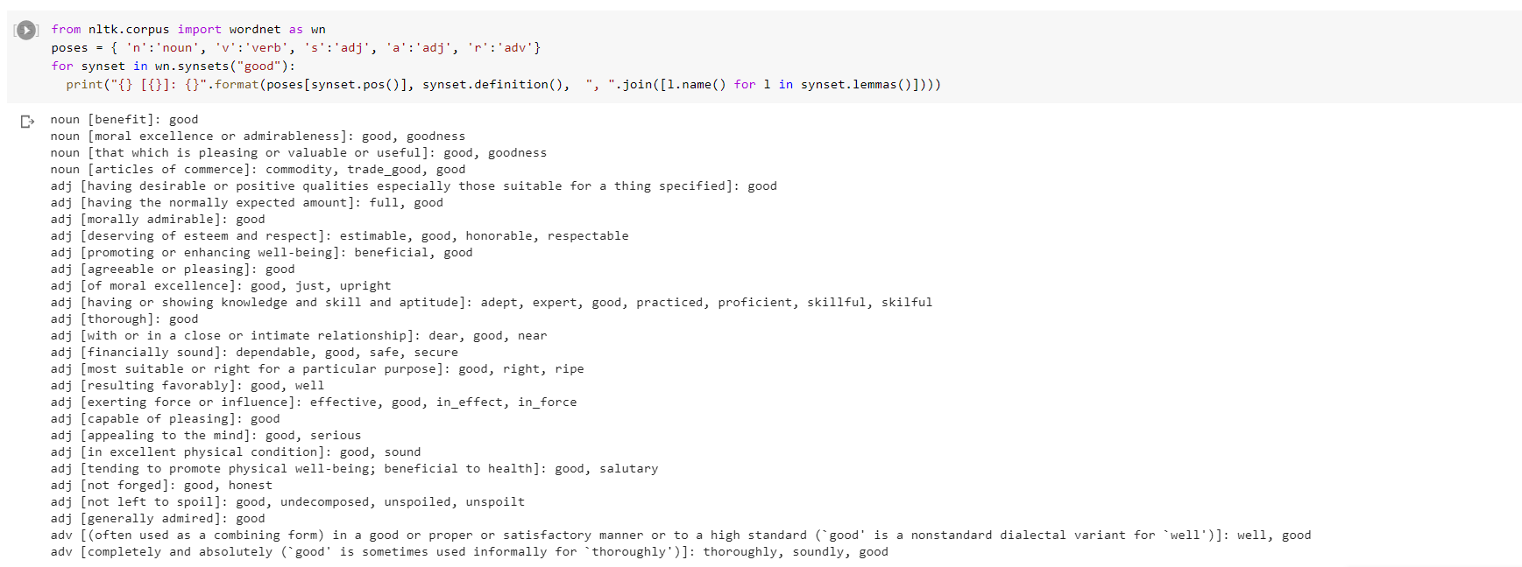
Exploring WordNet (Synonyms of Good)
Synonyms of Good Goodness, commodity, trade good, estimable, honorable, respectable, beneficial, just, upright, adept, expert, practiced, proficient, skillful, dear, near, safe, secure, dependable, well, effective, in effect, in force, serious, sound, salutary, honest, undecomposed, unspoiled, unspoilt
Code and example adapted from CS224n from Chris Manning

Slide 56
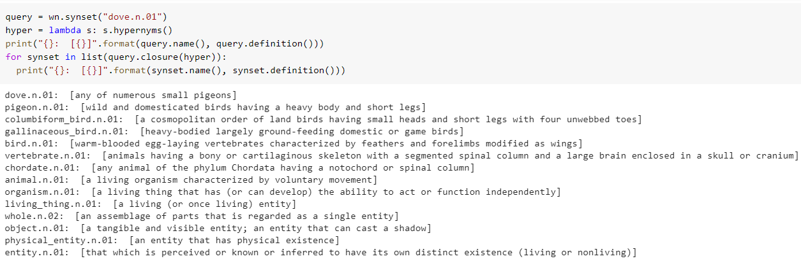
Exploring WordNet (Hyponyms of Dove)
Visualization: https://morningmoni.github.io/wordnet-vis/
Code adapted from CS224n from Chris Manning

Slide 57
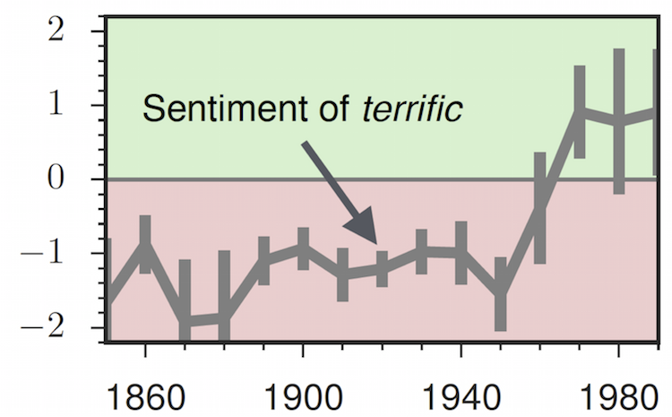
Shortcomings for WordNet (and Ontologies in General)
Missing nuance (only lexical semantics):
- e.g., “unspoiled” is listed as a synonym for “good”
Language isn’t stationary:
- e.g., “terrific”
Requires human labor
- Both expensive and subjective!
Machine Learning time (Yet again)
Slide adapted from Chris Manning

Slide 58

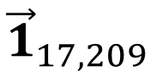
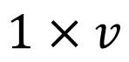
Words as Discrete Symbols From a Machine Learning Perspective
dove.n.01 Symbol
17,209
ID in Vocab
One-hot Vector
vocab
$${\vec{1}}_{17,209}$$
0, 0, 0, . . ., 0,1,0, … , 0 ,0 ,0
$$1×v$$
Only 17,209th entry is 1, all others zero

Slide 59

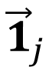
Words as Discrete Symbols From a Machine Learning Perspective
dove.n.01 Symbol
17,209
ID in Vocab
One-hot Vector
vocab
$${\vec{1}}_{j}$$
0, 0, 0, . . ., 0,1,0, … , 0 ,0 ,0
$$1×v$$
Only j^{th} entry is 1, all others zero
Vocab Size

Slide 60
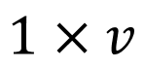
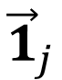
Words as Discrete Symbols From a Machine Learning Perspective
$${\vec{1}}_{j}$$
0, 0, 0, . . ., 0,1,0, … , 0 ,0 ,0
$$1×v$$
Vocab Size Easily 2,000,000
Concern: One-hot vectors are large and orthogonal.
Going to have to learn lots of parameters if we train a model
No good notion of similarity

Slide 61
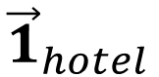
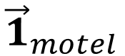
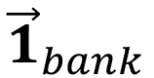
Words as Discrete Symbols From a Machine Learning Perspective
$${\vec{1}}_{motel}$$
0, 0, 0, 0,1,0,0 ,0 ,0
$${\vec{1}}_{hotel}$$
1, 0, 0, 0,0,0,0 ,0 ,0
$${\vec{1}}_{bank}$$
0, 0, 0, 0,0,0,0 ,1 ,0

Slide 62

Word Vectors
Idea: Learn a continuous vector for each word that captures things like similarity between words.
Next Time: The distributional hypothesis and learning continuous word-vectors with word2vec

Slide 63
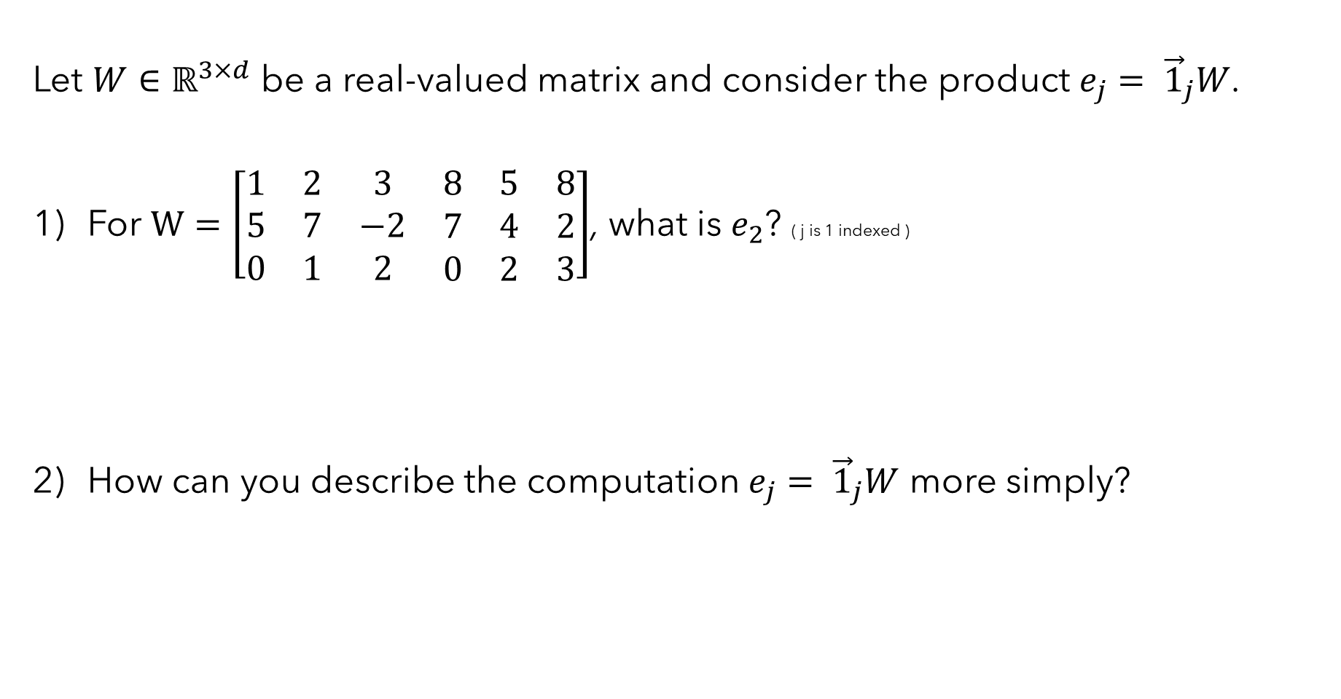
Let $W∈ℝ^{3×d}$ be a real-valued matrix and consider the product $e_{j}= {\vec{1}}_{j}W$.
For $W=\left[\begin{matrix}\begin{matrix}1 & 2 & 3 \\ 5 & 7 & −2 \\ 0 & 1 & 2\end{matrix} & \begin{matrix}8 & 5 & 8 \\ 7 & 4 & 2 \\ 0 & 2 & 3\end{matrix}\end{matrix}\right]$, what is $e_{2}$? ( j is 1 indexed )
How can you describe the computation $e_{j}= {\vec{1}}_{j}W$ more simply?

